Slide 1
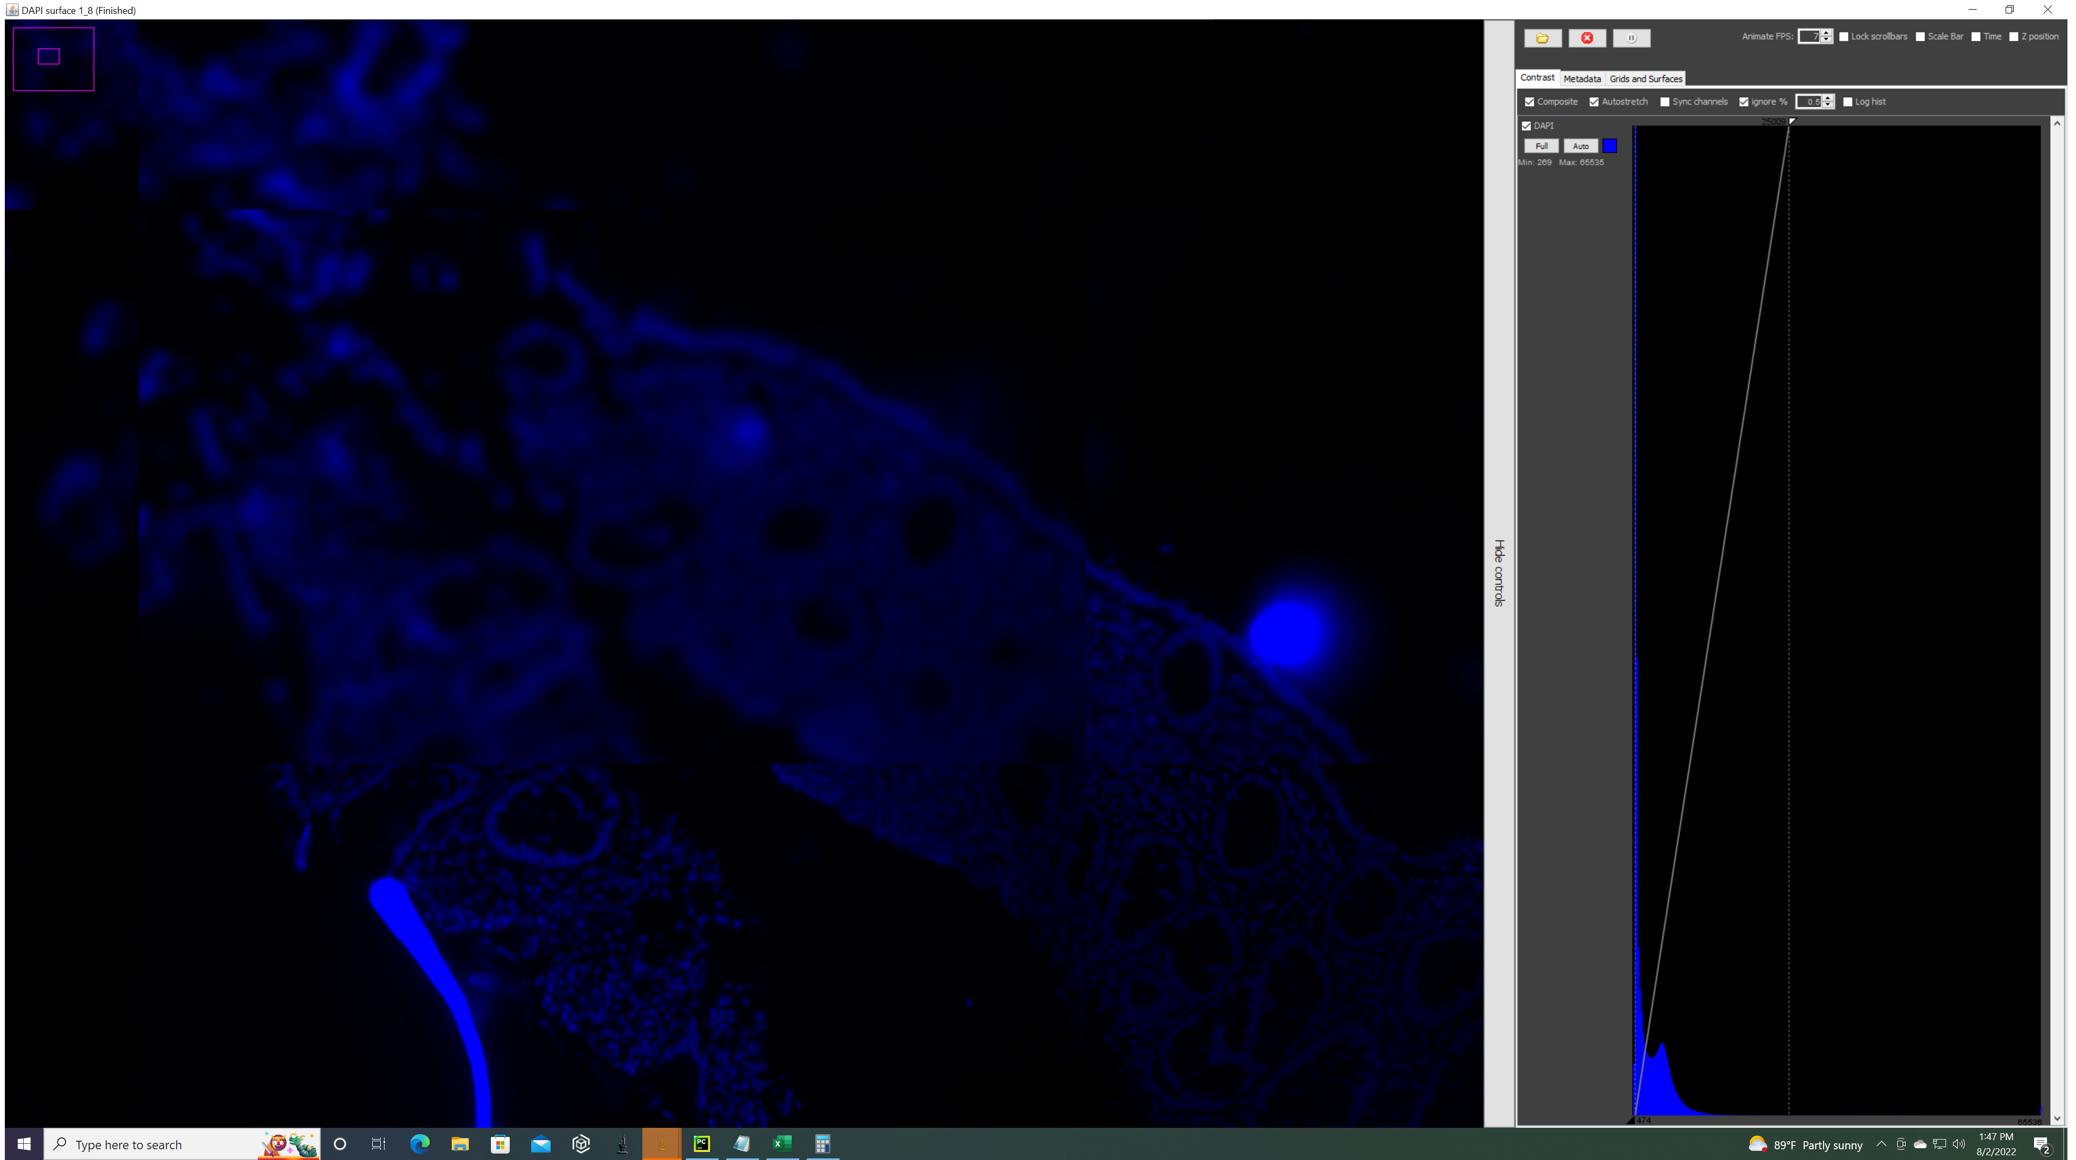

Slide 2
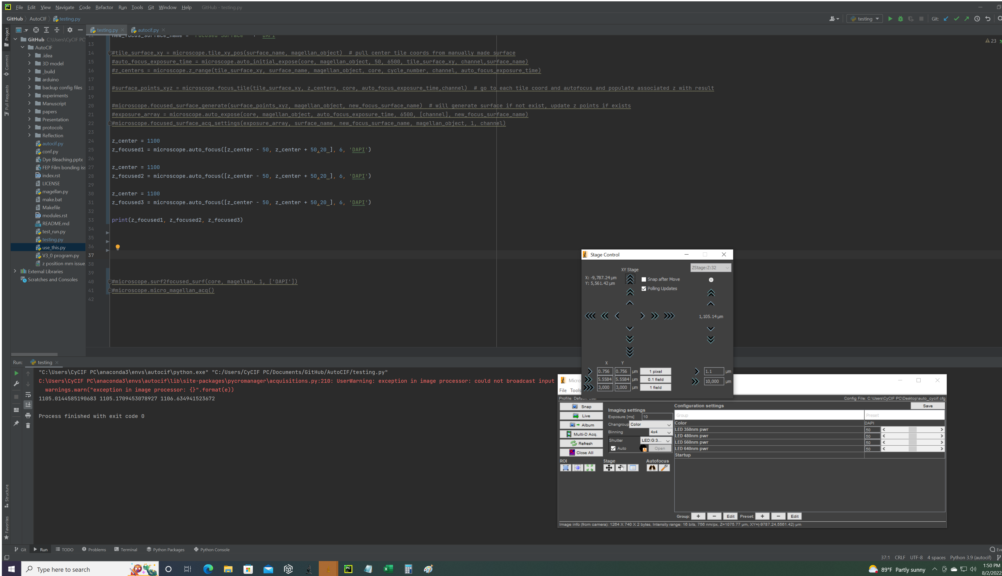
Move to location of unfocused part and autofocus 3 times there and set focus in auto focused z plane

Slide 3
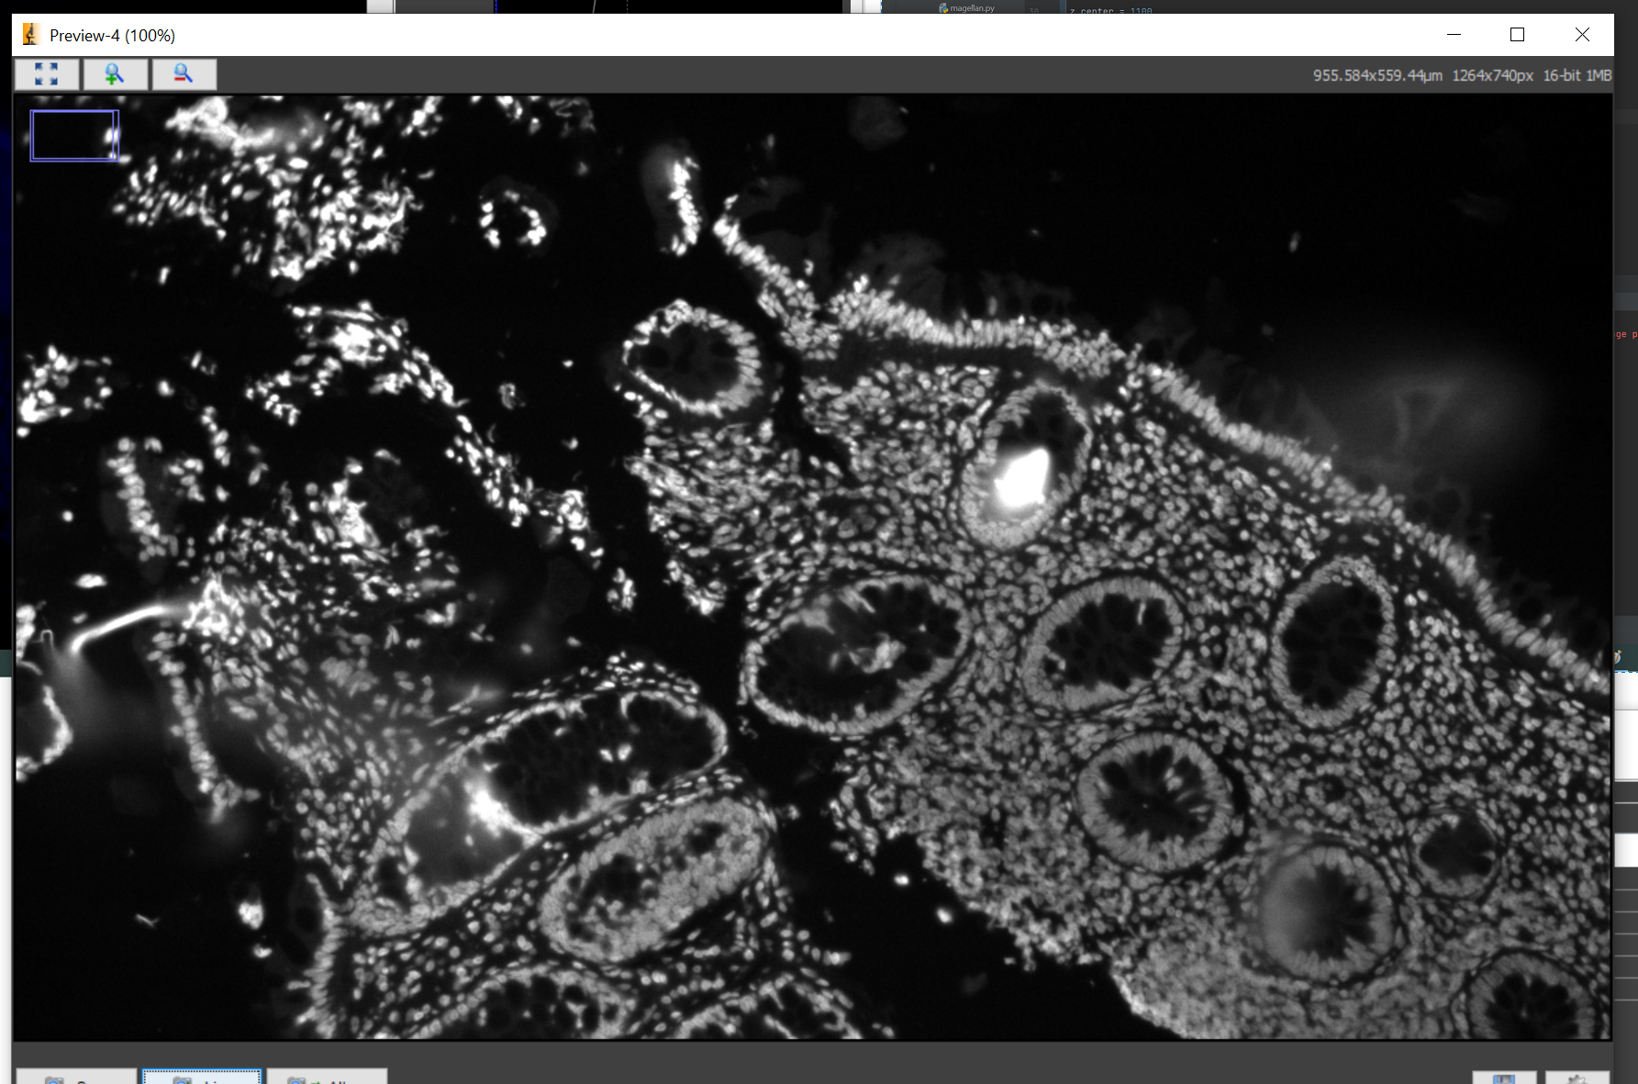
Auto focused image of same spot that was blurry

